Slide 1
Azure security and management

Slide 2
Abstract and learning objectives
In this whiteboard design session, you will work in a group to examine Contoso's enterprise environment with resources hosted on both on-premises and Azure. In a small working team, you will whiteboard design how Azure Security Center, Key Vault, Update management, as well as Azure Monitor and Application Insights, can help secure and well manage applications and virtual machines. You will also have the opportunity to design governance through Azure Policy.
At the end of this whiteboard design session, you will be better able to design a security and management solutions in Azure including inventory tracking and management, application performance monitoring, preventative maintenance and application and security alerting.

Slide 3
Step 1: Review the customer case study
Outcome
Analyze your customer needs.
Timeframe
15 minutes

Slide 4
Customer situation - Contoso
Contoso Holdings is a multi-national holding company headquartered in Los Angeles, CA that owns 48 manufacturing subsidiaries located in North America, Europe and Asia.
These subsidiaries sell their products primarily to either distributors or large retail organizations around the world.
Contoso, as the parent company, runs all of their 125 e-commerce based applications, used primarily for business-to-business purchasing by corporate buyers.
Notes:
Contoso Holdings is a multi-national holding company headquartered in Los
Angeles, CA that owns 48 manufacturing companies located in North America,
Europe and Asia. These companies sell their products primarily to distributors
or large retail organizations around the world. Contoso, as the parent company,
controls the IT systems for the companies that it owns and thus runs their
e-commerce based applications. There are about 125 of these e-commerce
applications used primarily for business-to-business purchasing by corporate
buyers. These apps provide the bulk of Contoso's 15 billion dollars in revenue
per year, so they are mission critical.

Slide 5
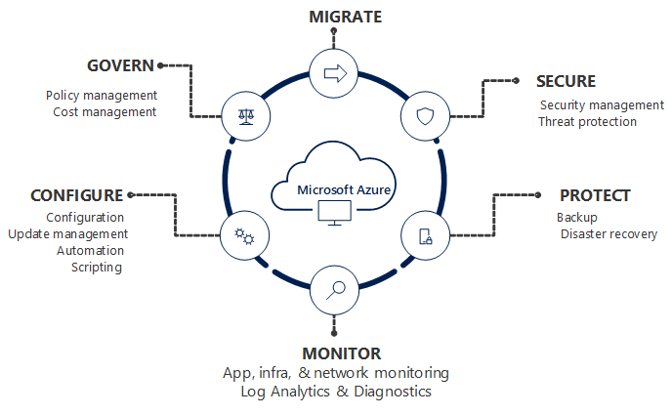
Customer situation
"Contoso is following Microsoft's 'Migrate > Secure > Protect > Monitor > Configure > Govern' framework to plan our Azure migrations and ensure our Azure deployments meet best practices. We need help with certain parts of this process. In particular, we need to better understand how to secure our Azure infrastructure, and how to monitor both our infrastructure and our applications."
Roberto Milian VP of Development and IT Operations
Notes:
Per Roberto Milian, VP of Development and IT Operations, "Contoso's primary
concern is how to best: deploy, test, manage, monitor, patch, secure and
troubleshoot these applications in Azure IaaS."
Milian's team is heavily investing in DevOps and already uses PowerShell DSC with
their applications. Six of their key Architects have just recently attended an
Azure DevOps training class where they learned how to create and leverage ARM
Templates. TS wants to have all applications deployed in an "Infrastructure as
Code" model, along with being configured and maintained using Azure Automation
DSC.
Contoso is looking for management tools that will allow them to have a full
end-to-end view of both the infrastructure's status and application's
performance. They do not have time or money to instrument the applications, but
they realize that they need a deeper understanding of their applications as they
have had performance issues in the past. Contoso would also like to be able to
run ad-hoc performance tests with very limited scripting.
Latisha Downs is the Global Service Management Lead for Contoso. During
discussions with her team, she was very passionate about ensuring Service
Continuity. "Of course, there is the need to have constant 'up/down' monitoring
of the sites and these tests need to be global in nature. The tool needs to
support our ability to create customized alerts that notify the Services
Operations Center (SOC) via emails into our trouble-ticket system." Downs also
mentioned during that meeting, it was clearly important to provide their service
desk personnel with mobile access to the monitoring system. Robert noted, "I
want to give them visibility no matter where they are located, and empower them
with the current status of the system by pushing alerts to their smartphones."
Having an easily customizable dashboard integrated with the Azure Portal is very
important to Contoso, as they do not want to have multiple "panes of glass" to
manage and monitor Azure. An integrated experience will reduce the learning
curve, since they are already having to learn the Azure Portal.
Of course, security is on the top of the chain, so they also need a security
solution and update management system. Since Contoso's business leverages all
e-commerce based applications, they need to ensure that only the appropriate
level of access to the system is allowed and they need to be alerted if systems
are being attacked.

Slide 6
Customer situation
Contoso’s CIO Jane Fields said in their last executive briefing, “we need to optimize our architecture and move away from our bricks and mortar datacenters, but it must be done in a way where we can retain or even improve our ability to ensure our systems are monitored and secured.”
Recently Contoso has started to investigate what it would take to move from on-premises datacenters to the cloud.
The majority of their applications are ASP.NET running on Windows VMs with SQL Server in a traditional N-tier configuration.
Their goal is to lift and shift all of these applications over to the cloud while gaining more control over the applications and improving their security posture.
Notes:
Contoso's CIO Jane Fields said in their last executive briefing, "we need to
optimize our architecture and move away from our brick and mortar datacenters,
but it must be done in a way where we can retain or even improve our ability to
ensure our systems are monitored and secured."
Recently Contoso has started to investigate what it would take to move from
on-premises datacenters to the cloud. Most of their applications are ASP.NET
running on Windows VMs with SQL Server in a traditional N-tier configuration.
Their goal is a lift and shift of these applications over to the cloud while
gaining more control over the applications and improving their security posture.

Slide 7
Customer situation
Roberto is heavily investing in DevOps.
Contoso is looking for management tools that will allow them to have a full end-to-end view of both the infrastructure’s status and application’s performance.
Contoso does not have time or money to instrument the applications, but they realize that they need deeper understanding of their applications as they have had performance issues in the past.
Contoso also wants a customizable dashboard, security tools and mobile access to all of these systems with the ability get notified when there are issues.
Notes:
Milian's team is heavily investing in DevOps and already uses PowerShell DSC with
their applications. Six of their key Architects have just recently attended an
Azure DevOps training class where they learned how to create and leverage ARM
Templates. TS wants to have all applications deployed in an "Infrastructure as
Code" model, along with being configured and maintained using Azure Automation
DSC.
Contoso is looking for management tools that will allow them to have a full
end-to-end view of both the infrastructure's status and application's
performance. They do not have time or money to instrument the applications, but
they realize that they need a deeper understanding of their applications as they
have had performance issues in the past. Contoso would also like to be able to
run ad-hoc performance tests with very limited scripting.
Latisha Downs is the Global Service Management Lead for Contoso. During
discussions with her team, she was very passionate about ensuring Service
Continuity. "Of course, there is the need to have constant 'up/down' monitoring
of the sites and these tests need to be global in nature. The tool needs to
support our ability to create customized alerts that notify the Services
Operations Center (SOC) via emails into our trouble-ticket system." Downs also
mentioned during that meeting, it was clearly important to provide their service
desk personnel with mobile access to the monitoring system. Robert noted, "I
want to give them visibility no matter where they are located, and empower them
with the current status of the system by pushing alerts to their smartphones."
Having an easily customizable dashboard integrated with the Azure Portal is very
important to Contoso, as they do not want to have multiple "panes of glass" to
manage and monitor Azure. An integrated experience will reduce the learning
curve, since they are already having to learn the Azure Portal.
Of course, security is on the top of the chain, so they also need a security
solution and update management system. Since Contoso's business leverages all
e-commerce based applications, they need to ensure that only the appropriate
level of access to the system is allowed and they need to be alerted if systems
are being attacked.

Slide 8
Customer needs
Contoso wants to continue to embrace their move toward DevOps techniques as they move to Azure, especially infrastructure as Code and automated configuration management for their applications.
Contoso needs to ensure that all of the diagnostic data for the systems are rolled up together to support their ability to troubleshoot outages and determine correlations between issues and errors to determine root cause of problems.

Slide 9
Customer needs
Contoso needs a full infrastructure monitoring and management solution that has the following abilities:
Capture machine data and make it searchable.
Software Update Management to ensure VMs have the latest patches.
Contoso needs to have the data to answer the question: “what changed?”, which always comes up during service outages.

Slide 10
Customer needs
Security is a must in the cloud age, so Contoso needs a great dashboard and set of solutions that can help them understand the current status of their deployment and capture all logs in case of a breach.
The ability to create custom alerts which can email the trouble-ticket system as well as send notification to smartphones.
Contoso truly relies on SQL Server for their 150 applications and they want proactive feedback on the status of these SQL Servers.

Slide 11
Customer needs
Contoso needs an Application Performance Monitoring (APM) Solution that can provide end-to-end monitoring and visibility of their applications:
The APM solution must allow the team to drill into the data and determine which pieces of the application are not performing well including the dependences such as the SQL Server.
Web monitoring solution that provides not only up/down tests from spots all over the globe, but also can tell them when the application is not performing as expected.

Slide 12
Customer needs
Performance testing capabilities to accomplish simple performance tests that will help them benchmark and size their VMs.
The ability to create application layer alerts, and these need to be able show up in the portal.
The solution needs to integrate with the management and monitoring solution. This means that all of the data from the APM should flow into the primary management system.
Contoso are looking for an integrated approach that offers consistency for log search, alerting, analytics and dashboarding across all of their monitoring and diagnostics data.

Slide 13
Customer objections
Contoso cannot change the code of any application as a part of this deployment, so all application monitoring must be done without instrumenting the code.
They believe Microsoft works hard to secure the Azure network, but they are unsure how to detect when hackers are attacking their system. How will Microsoft’s solution ensure we have visibility into our security posture?

Slide 14
Customer objections
SQL Server is used extensively in their application eco-system, FT is concerned about proper configuration and are worried that SQL may not perform adequately on VMs in Azure. The system has to provide feedback on proper configurations and the ability to drill into how the system is performing even down to the query level as dependences to their ASP.NET applications.
Contoso are concerned about the administrative controls. They would like to ensure that only approved administrators have access to manage virtual machines.

Slide 15
Customer objections
Contoso are also concerned about how to control Azure usage without limiting agility. They want to ensure governance controls are in place across all their subscriptions to prevent usage of un-approved resources.
Contoso would also like to ensure all Azure VMs use best practice disk encryption, with key management in accordance with Contoso company policies.

Slide 16
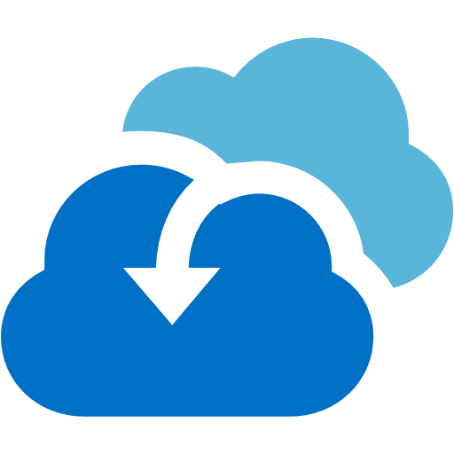

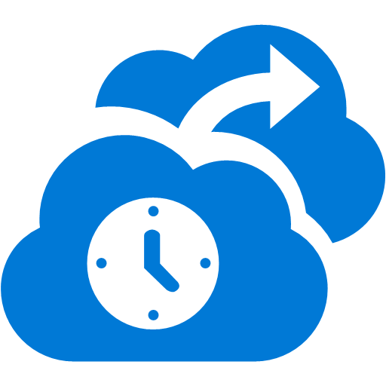



Common scenarios
Migrate
Secure
Protect
Azure Migrate to assess your environment and Site Recovery to replicate and migrate virtual machines.
Azure Security Center helps secure your workloads, servers, and users across the cloud and on-premises.
Azure Backup and Site Recovery provide business continuity for disaster recovery scenarios.
Monitor
Configure
Govern
Azure Monitor for insight into app, infrastructure, and network diagnostics and telemetry.
Azure automation/DSC, update & patch management for automated configuration management.
Policies, access control, and cost management to apply governance across your Azure subscriptions.

Slide 17
Step 2: Design the solution
Outcome
Design a solution and prepare to present the solution to the target customer audience in a 15-minute chalk-talk format.
Timeframe
60 minutes
Business needs (10 minutes) | Respond to questions outlined in your guide and list the answers on a flipchart.
Design (35 minutes) | Design a solution for as many of the stated requirements as time allows. Show the solution on a flipchart.
Prepare (15 minutes) | Identify any customer needs that are not addressed with the proposed solution. Identify the benefits of your solution. Determine how you will respond to the customer’s objections. Prepare for a 10-minute presentation to the customer.

Slide 18
Step 3: Present the solution
Outcome
Present a solution to the target customer in a 15-minute chalk-talk format.
Timeframe
30 minutes (15 minutes for each team to present and receive feedback)
Directions
Pair with another table.
One table is the Microsoft team and the other table is the customer.
The Microsoft team presents their proposed solution to the customer.
The customer asks one of the objections from the list of objections in the case study.
The Microsoft team responds to the objection.
The customer team gives feedback to the Microsoft team.

Slide 19
Wrap-up
Outcome
Identify the preferred solution for the case study.
Identify solutions designed by other teams.
Timeframe
15 minutes

Slide 20
Preferred target audience
Jane Fields, Chief Information Officer
Roberto Milian, VP of Development and IT Operations
Latisha Downs, Global Service Management Lead
Notes:
The primary audience are the business and technology decision makers. From the
case study scenario, this would include the CIO, VP of Development and IT
Operations and the Global Service Management Lead. Working at each level for
sponsorship and buy in will be important to the success of the solution.

Slide 21
Preferred solution
Contoso and Microsoft have worked closely along with a partner, to design a solution that meets the needs for migrating the e-commerce applications to Azure. A “Lift & Shift” approach is being proposed.
The design consists of using Azure Resource Manager, along with several Microsoft Cloud monitoring and management products:
Azure DevOps
Azure Security Center
Azure Monitor
Azure Log Analytics
Azure Application Insights
Azure Network Watcher
Notes:
- **Azure Resource Manager** is the management interface that is used to
deploy and manage applications. In the case of Contoso, they have moved to a
DevOps model for the deployment and management of their Infrastructure.
Using ARM Templates along with a Source Control solution, provides the
ability to automate and deploy their VMs in a repeatable manner without
human interaction. Once the template has been tested and deployed to
Azure, it will be checked into source control. All subsequent updates to
the systems will be made by checking the template out of source control,
making changes, testing them thoroughly, then deploying the updated
template via automation.
- **Azure Security Center**: Azure Security Center provides a unified view
into the security posture of your hybrid cloud workloads, enabling you
discover and assess the security of your workloads and to identify and
mitigate risk.
- **Azure Monitor:** Azure Monitor provides base-level infrastructure
metrics and logs for most services in Microsoft Azure. Azure services
that do not yet put their data into Azure Monitor will put it there in
the future.
- **Log Analytics** provides centralized log ingestion and in-depth
analytics. A variety of 'solution packs' within Log Analytics will be
used, for update management, change tracking and understanding
application dependencies. Azure Security Center also uses Log Analytics
as its underlying engine.
- **Application Insights:** Application Insights is an extensible APM
service for web developers on multiple platforms. It can be used to
monitor the Contoso live web applications. The data supplied to the Azure
Portal is captured either at Runtime and/or by instrumenting an
application. Each application will be fitted with the Applications
Insight Status Monitor which is installed on the IIS servers and captures
data at runtime and sends it to the Azure Portal. All the Applications
Insights portals will then be connected to Log Analytics via the
Applications Insights solution. App Insights has many capabilities that
meet the monitoring, alerting, testing and dependency drill through that
Contoso stated are critical for their deployment.
- **Azure Automation** provides a framework for deploying application
updates and OS patches across the virtual machine infrastructure, using
PowerShell DSC.
- **Azure Network Watcher** provides additional visibility into network
configuration, traffic and performance. In particular, the Traffic
Analytics feature of Network Watcher helps understand your network
traffic flows, including identifying potentially malicious traffic.

Slide 22



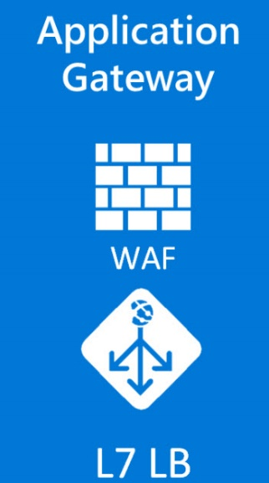







Proof of Concept Solution
Azure Management & Monitoring
Cloud Shop Application
Security Center
hackathonVNet
Unified view into the security posture of hybrid cloud workloads
Detect and respond to threats
AppGWVNet
VNet Peering
Log Data
Log Analytics
Single pane of glass for operational data
Azure Mobile App
Public IP
App GW
Azure Monitor
App Telemetry
Custom Notifications and Alerts
Environment Recommendations
Application Insights
Run-Time Application Telemetry Provided by Status Monitor
Web and Performance Testing
Automation DSC
WWW
SUBNET
DATA
SUBNET
Azure Automation
Desired Configuration Management using Runbooks
Update Management via Schedules using the Patch Management Solution
Change Tracking
VM Extension:
Azure DSC
App Insights:
Status Monitor
VM Agent

Slide 23
Solution Details – Azure DevOps
Azure DevOps service provides development collaboration tools
Using Azure DevOps as a Source Control solution, provides the ability to automate and deploy their VMs in a repeatable manor, without human interaction.
Azure DevOps will be used as managed CI/CD to deploy code / template.
All subsequent updates to the systems will be made by checking the template through Azure DevOps, making changes, testing them thoroughly and then deploy the updated template

Slide 24
Solution Details –Azure Automation
Azure Automation DSC (a solution that builds on top of the fundamentals introduced in PowerShell DSC) and can automate and manage the configuration of servers.
When the VMs are provisioning, they will communicate with Azure Automation and use Desired State Configuration to receive the application configurations.
This is a fully automated install and configuration management solution leveraging DevOps principles.

Slide 25
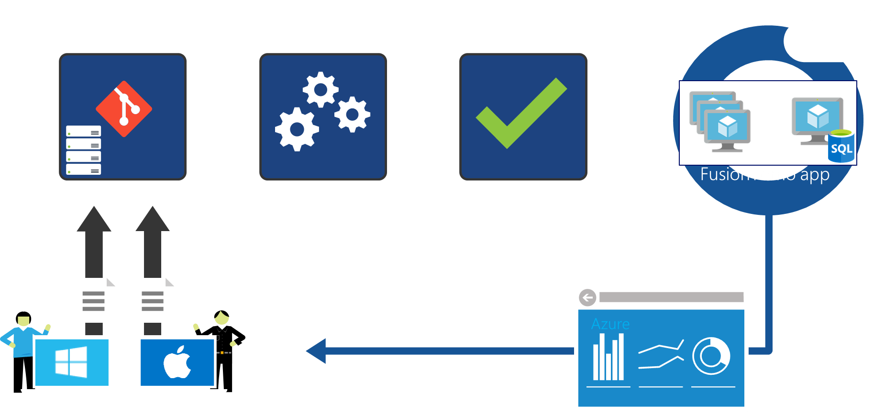
DevOps – People, process, and tools
2) Code repository
3) Build
4) Test
5) Deploy
1) Developers
6) Monitor and improve

Slide 26
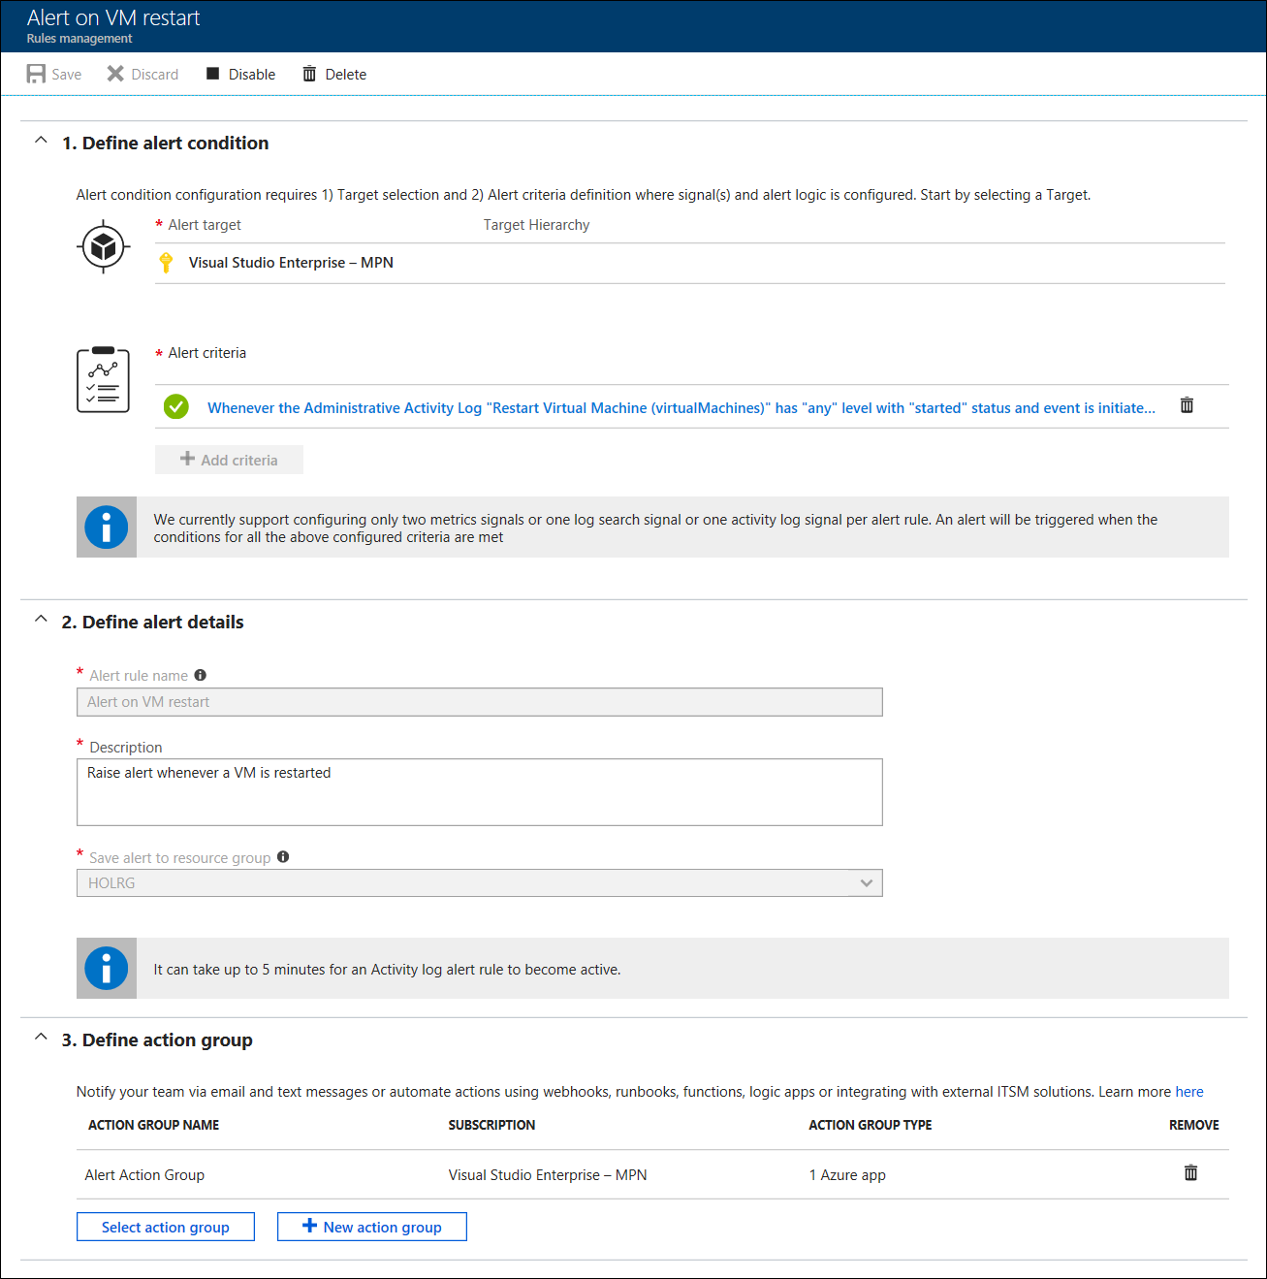
Solution details – Azure Monitor
Azure Monitor provides base-level infrastructure metrics and logs for most services in Microsoft Azure.
Azure Monitor supports alerts based on:
Metrics
Activity Log
Diagnostics Logs
Both the new and 'classic' alerts framework are supported.
For longer-term retention and in-depth diagnostics, Log Analytics will also be used.

Slide 27
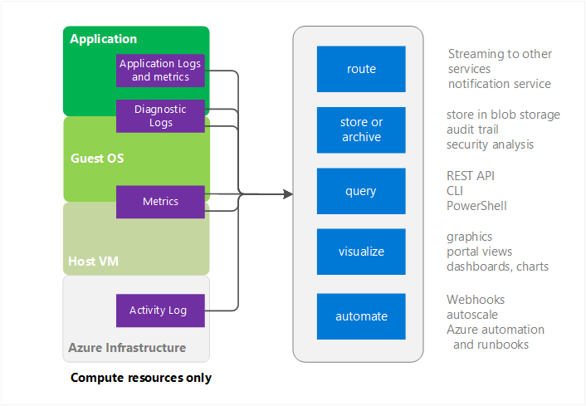
Solution Details – Azure Monitor
Ingest logs and metrics from multiple sources.
Supports storage, queries, visualization, and automation.
Integration with Application Insights, PowerBI, and third-party tools.
Consistent query language and alerting across toolsets.
Notes:
How can you deliver a single consistent experience for log search, alerting, analytics and dashboarding across all of Contoso's monitoring and diagnostics data?
- Azure Monitor supports ingesting logs and metrics from multiple sources. This includes application logs, diagnostic logs, and system metrics, such as CPU load, disk capacity, and network utilization. It can also ingest the Azure Activity Log, which records all Azure administrator activity.
- From this central hub, Azure Monitor supports log storage and archiving, log queries, visualization using the Azure Dashboard, and automation of follow-on tasks using Azure Automation.
- In addition, logs can be passed to other services, for example to Application Insights for deeper analytics, and PowerBI for more detailed investigation and reporting. Logs can also be routed to other services, including third-party services, via Azure Event Hub.
- Application Insights, Azure Monitor and Azure Log Analytics use the same query language (Kusto Query Language), making it easy for administrators to learn a single approach to querying all data sources.
- Azure Monitor also enables alerts to be configured, again providing a single consistent hub for managing all alerts across the platform.

Slide 28
Solution details – Log Analytics
A Log Analytics Workspace will be provisioned using the Azure portal and all of the systems that make up the Contoso deployments.
The following solutions will be added:
Update Management
Change Tracking
SQL Server Health Check
Application Insights Connector
This Workspace will also be used by Security Center and Network Watcher.

Slide 29
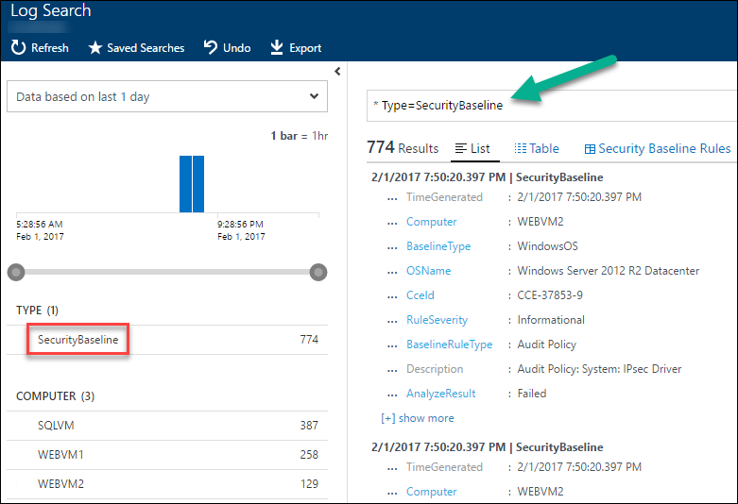
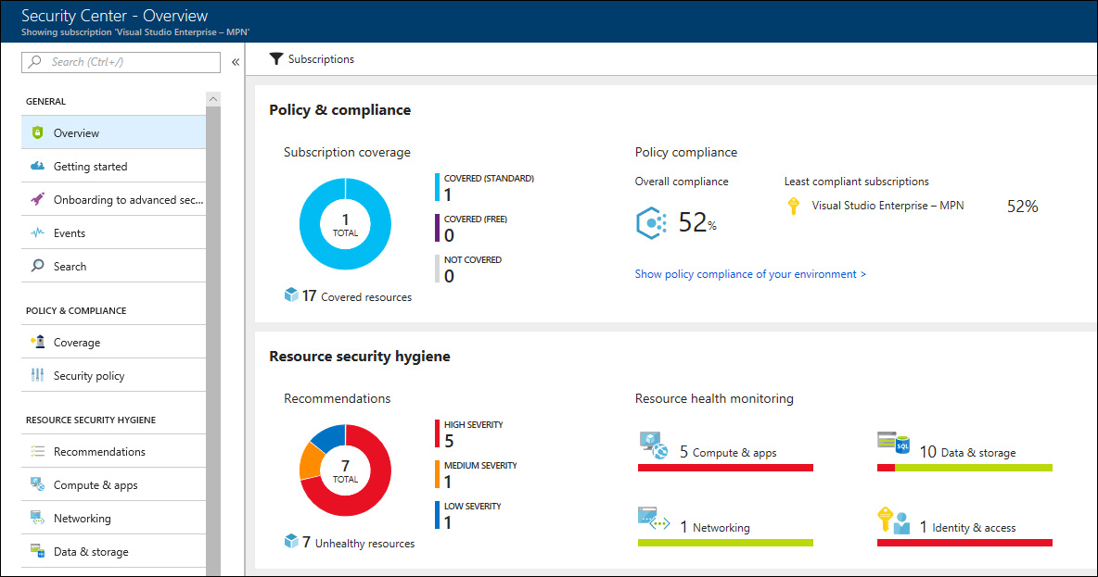
Solution details – Management and monitoring
Log collection, search and analytics
Security Center
Notes:
- VM diagnostics will be enabled and configured to send logs to Log
Analytics capturing the correct events. All this data is indexed as it is
ingested for extremely fast searches from the Log Analytics interface.
This can be used by the various teams at Contoso to troubleshoot and correlate
issues between multiple machines/systems. It can also be used to create
custom alerts (from errors and warnings in the data) to give the team a
better understanding of what is happening to specific applications or
VMs. The more that the team uses this capability the better they will
become at working with machine data.
- Use the Infrastructure monitoring and management solution, which supports
log collection, search and analytics. All VMs will be added to the Log
Analytics platform, ensuring that log data from every Contoso system is
centralized (one portal experience) and indexed. This will allow for the
system to meet the needs of the all Contoso teams. Log Analytics solutions
that are enabled will provide pre-built queries and visualizations to
unlock immediate value from this massive amount of log data. Also,
ad-hock queries can be performed an easy to learn query language.
Security Dashboards and Forensics
Azure Security Center provides a unified view into the security posture
of your hybrid cloud workloads, enabling you to discover and assess the
security of your workloads and to identify and mitigate risk. Using
Azure Security Center will allow Contoso:
**Centralized policy management** -- Ensure compliance with company or
regulatory security requirements by centrally managing security policies
across all hybrid cloud workloads.
**Continuous security assessment** -- Monitor the security of machines,
networks, storage and data services, and applications to discover
potential security issues.
**Actionable recommendations** -- Remediate security vulnerabilities
before they can be exploited by attackers with prioritized and
actionable security recommendations.
**Advanced cloud defenses** -- Reduce threads with just in time access
to management ports and whitelisting to control applications running on
VMs.
**Prioritized alerts and incidents** -- Focus on the most critical
threats first with prioritized security alerts and incidents.
**Integrated security solutions** -- Collect, search, and analyze
security data from a variety of sources, included connected partner
solutions.

Slide 30
Solution details – Log Analytics Query Example
Chart the number of alerts raised per day, broken out by severity.
Alert
| where TimeGenerated > ago(7d)
| summarize count() by AlertSeverity, in(TimeGenerated, 1d)
| render barchart kind=unstacked
See more examples at:
https://github.com/MicrosoftDocs/LogAnalyticsExamples/tree/master/log-analytics

Slide 31
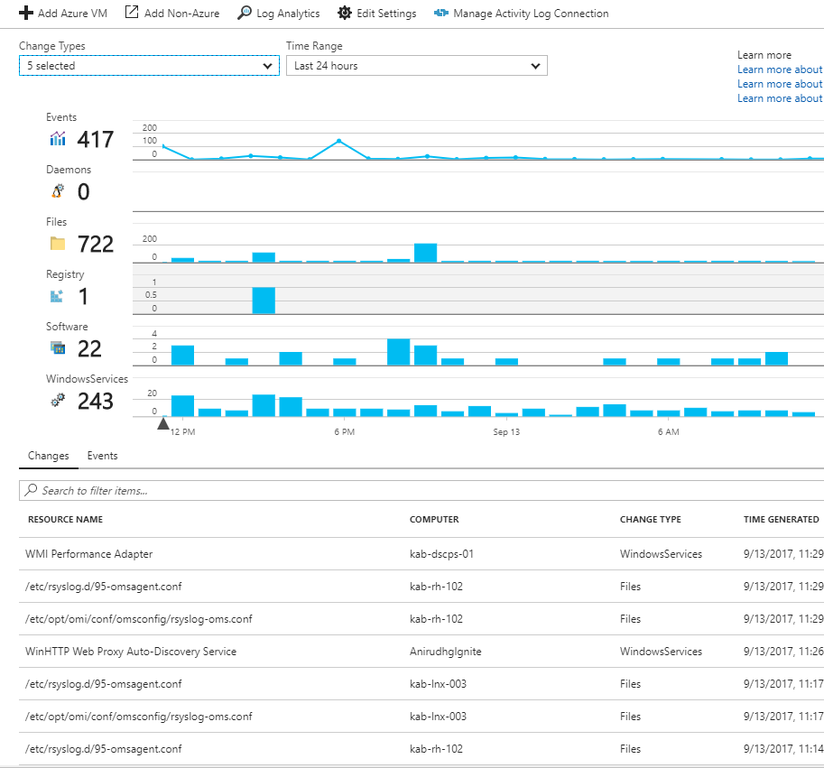
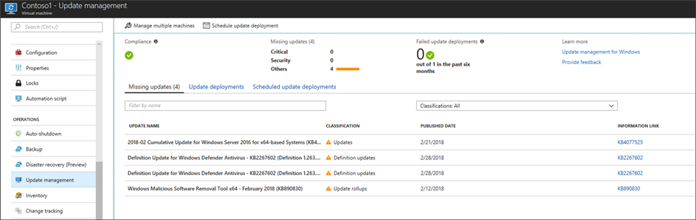
Solution details – Management and monitoring
Change tracking
Update management
Notes:
Change Tracking
- The Change Tracking Solution uses Log Analytics data to identify changes
in the environment. The solution will track changes to Windows/Linux
Software, Windows Files, Windows Services, and Linux daemons. This allows
the technical team to monitor and drill into specific machines to answer
the question of, "what changed?", which always comes up during an outage
or troubleshooting session for a service that is having issues. The
following changes can be viewed: changes by configuration type for
software and services, software changes to applications and updates to
servers, total number of changes for each application, Linux packages,
Windows service change for individual servers and Linux daemon changes.
Patch Management Compliance
- Ensuring that all the VMs have the correct patch levels is critically
important. Using the Update Management automation solution allows for
managing the updates for Windows and Linux VMs.
- The Services Operations Center (SOC) can check the patch status of any VM
simply by navigating to the 'Update Management' tile on the virtual machine blade.
- The Service Operation Center (SOC) can also get an all-up view of update
status across their Azure VMs by navigating to the 'Update Management'
tile of their Azure Automation account.
- From either the virtual machine blade or the Azure Automation blade, there
is also the ability to create an "Update Deployment", which will then
schedule installation of the required updates for the VMs. You can
configure which machines will be updated, when the update will run, which
updates to include (based on classification), and which to exclude (based
on KnowledgeBase IDs). You can also configure the duration of the
maintenance window (if not all updates are completed in this time,
remaining updates are skipped so the VMs can be brought back online). Once
submitted, this creates an Azure Automation Runbook that will kick off the
install of the updates. Of course, access to either a WSUS server, or
access to Microsoft Update, is required.

Slide 32
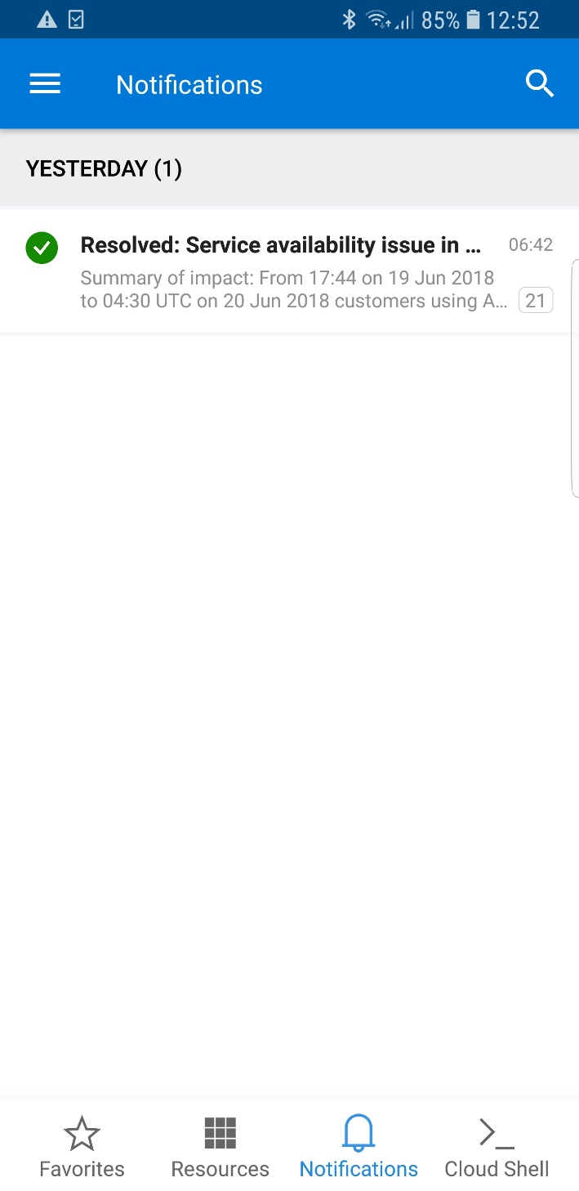
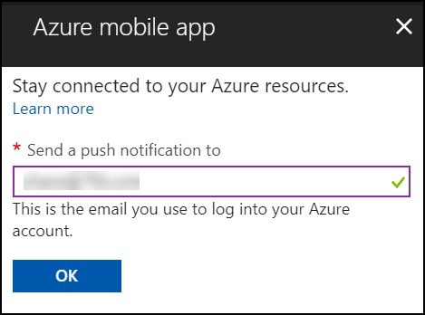
Solution details – Mobile solution
Notes:
- Azure has a mobile application which is installable on both iPhone and
Android. This allows administrators to be able to have access to a
smartphone formatted tool for viewing the dashboard. There is the
capability to view or create custom dashboards on the phone. This mobile
application also will allow for push notifications to these smart devices,
so that alerts will come through as true smartphone notifications.

Slide 33
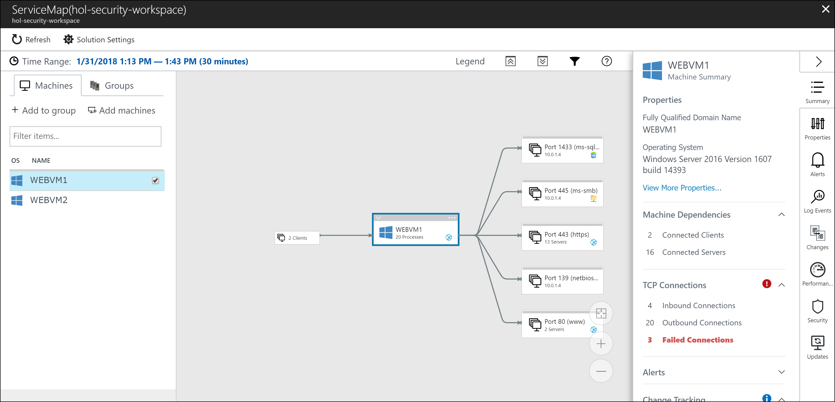
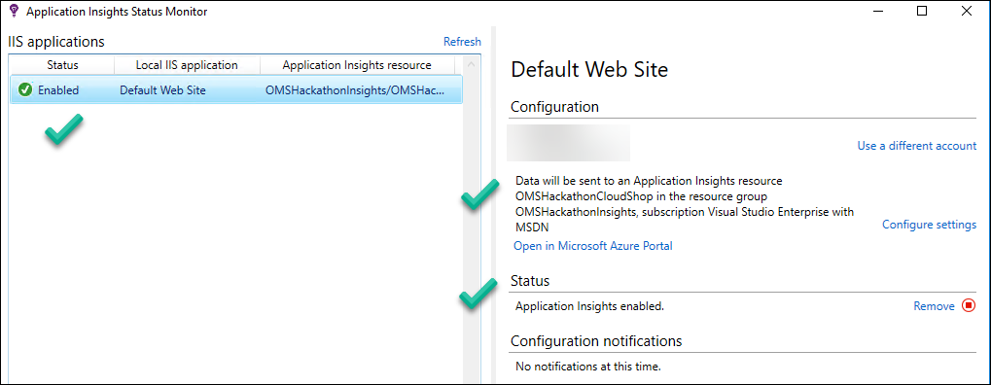
Solution details – App performance management
Runtime Application Insights Status Monitor
Service map

Slide 34
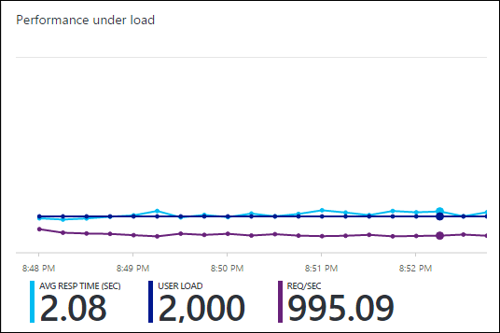
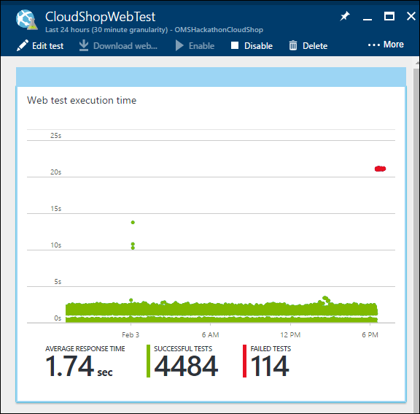
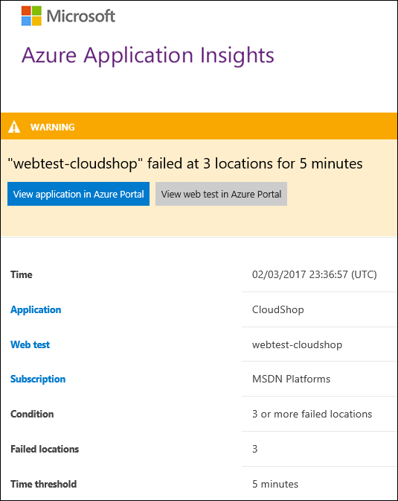
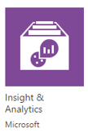
Solution details – App performance management
Global up/down Web tests
Perf tests
Integrated with Application Insights and Analytics
Notes:
- Up/Down Web tests from all over the world
Ensuring availability of these e-commerce sites for Contoso is critical.
Web Tests can be setup to monitor both the availability and the
responsiveness of the sites. These tests can have origins from all over
the world and will sent web request at regular intervals. Then it will
alert the SOC if the site does not respond or is performing poorly.
There are two types of tests: URL Ping Test and Multi-Step Web Tests.
The SOC team can create up to 10 tests for each site.
- Performance Testing to ensure scalability
Using the Load Testing feature of Application Insights allows the
Engineering teams to create a true load test of the application as
deployed in Azure. There is the ability to use either web tests that
developers have built or the ability to do a simple Manual test by
providing URLs to the portal. These tests can simulate the activity of
many thousands of users. During this time, useful data will flow into
the Applications Insights portal detailing how the application will
perform during load. This load testing capability can also be used to
trigger alerts that the SOC has built to ensure that they are working
properly (expected actions from Alerts and automatic resolution once
issues are resolved).

Slide 35
Solution Details – Consistency
Application Insights is an extensible Application Performance Management (APM) service for web developers on multiple platforms.
Each application server will be fitted with the Applications Insight Status Monitor which captures data at runtime and sends it to the Azure Portal (no code changes required).
All of these Applications Insights portals will then be connected to Log Analytics via the Applications Insights solution.
Application Insights has many capabilities that meet the monitoring, alerting, testing and dependency drill through that Contoso stated are critical for their deployment.

Slide 36
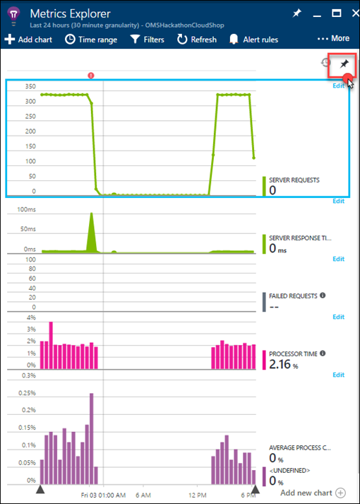
Preferred objections handling
Objection
Contoso cannot change the code of any application as a part of this deployment, so all applications monitoring must be done without instrumenting the code.
Potential answer
Given that Azure Application insights has the ability to capture application data at run-time using the Status Monitor, FT will have rich application specific information that they have lacked in the past. This new visibility into their e-commerce implementations is a huge benefit, and a big win for them moving to the platform. This will also work with their existing applications that might remain on-premises.

Slide 37
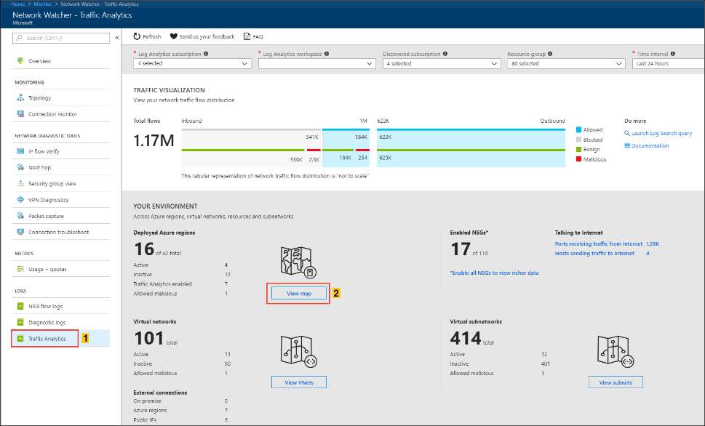
Preferred objections handling
Objection
They believe Microsoft adequately secures the Azure platform, but they are unsure how to detect when hackers are attacking their deployments on the Azure platform. How will Microsoft’s solution ensure we have visibility into our security posture?
Potential answer
Security Center's continuous assessment helps to discover potential security issues, such as systems with missing security updates or exposed network ports.
Network Watcher Traffic Analytics analyzes Network Watcher network security group (NSG) flow logs to provide insights into traffic flow in your Azure cloud.

Slide 38
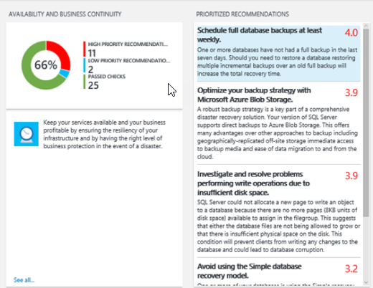
Preferred objections handling
Objection
SQL Server is used extensively in their application eco-system. Contoso is concerned about proper configurations and has concerns about how SQL will perform on VMs Azure. The system has to provide feedback on proper configurations and the ability to drill into how the system is performing, even down to the query level, as dependences to their ASP.NET applications.
Potential answer
The SQL Server Assessment that is part of Security Center can be implemented with just a few clicks by Contoso. This assessment will run once a week and the teams can stay ahead potential issues and will have step-by-step remediation’s to know problems and misconfigurations.

Slide 39
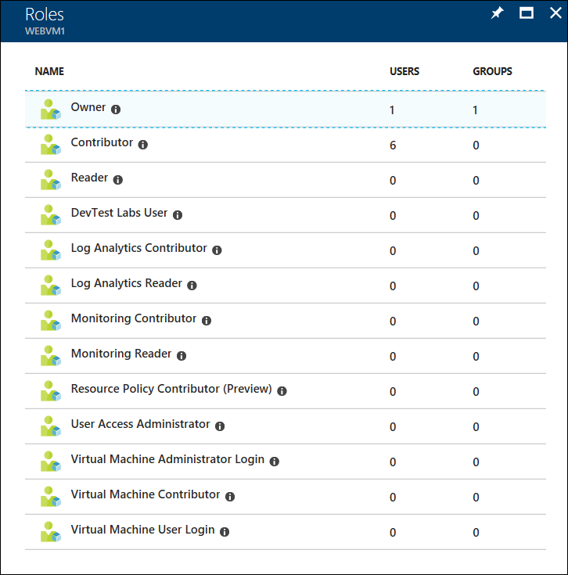
Preferred objections handling
Objection
Contoso are concerned about the administrative controls. They would like to ensure that only approved administrators have access to manage virtual machines.
Potential answer
Contoso can use Role-Based Access Control (RBAC) to ensure that only approved staff (individuals or groups) are able to manage each deployment.
Read-only or read-write permissions can be applied at the subscription, resource group, or individual resource level.
Contoso can use the built-in role definitions or create custom role definitions tailored to their precise security needs.

Slide 40
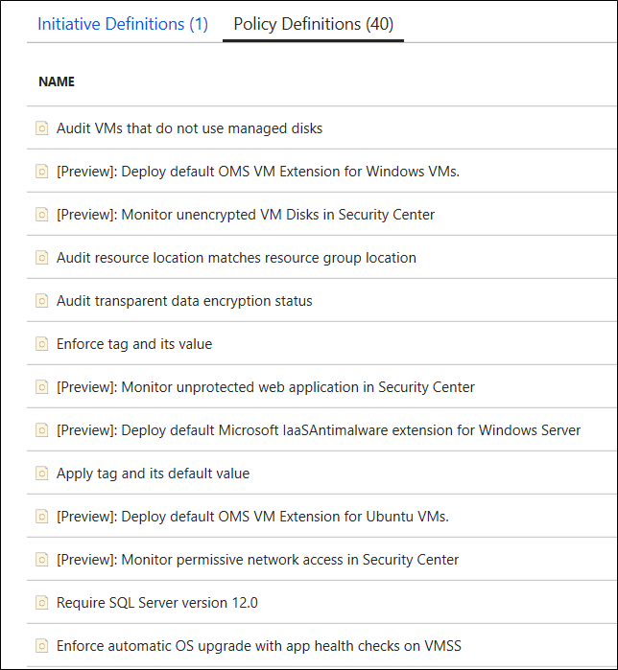
Preferred objections handling
Objection
Contoso are also concerned about how to control Azure usage without limiting agility. They want to ensure controls are in place across all their subscriptions to prevent usage of un-approved resources.
Potential answer
Contoso can use Azure Policy to control which resources can be provisioned. This prevents unapproved resources from being deployed (regardless of RBAC permissions).
By deploying Azure Policy at the Tenant Root Management Group scope, rather than at the Azure subscription scope, the Policy will automatically be applied to all subscriptions within their tenant.
Notes:
Note however that Azure Policy does not
control the number of resources that may be provisioned (if a given VM SKU
is permitted, then a user could create 1 VM or 100). Other mechanisms,
such as Azure Automation and Azure Monitor, can be used to provide further
control and alerting.

Slide 41
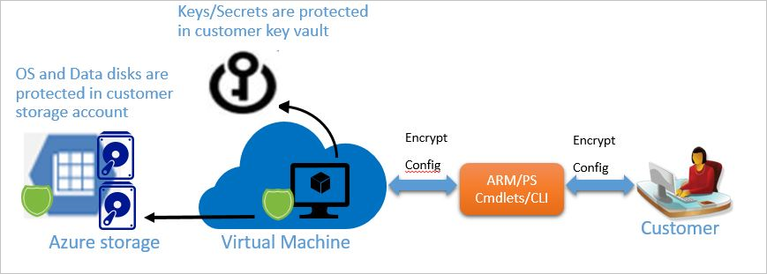
Preferred objections handling
Objection
Contoso would also like to ensure all Azure VMs use best practice disk encryption, with key management in accordance with Contoso company policies.
Potential answer
All Azure VM disks (both managed and unmanaged) benefit from the always-on Azure Storage Service Encryption, using Microsoft-managed keys.
In addition, Azure supports VM-level disk encryption, using Bitlocker (Windows) and DM-Crypt (Linux). This solution takes advantage of Azure Key Vault enabling the customer to control and manage the disk encryption keys.

Slide 42
Customer quote
“As we jump into Azure, I’m confident that we have the right tools to ensure that our systems will perform as needed and be secure. The best part is the visibility our teams have, end-to-end, from the Applications and SQL, down to the infrastructure.”
- Roberto Milian, VP of Development & IT Operations, FT

Slide 43
Notes:
Information in this document, including URL and other Internet Web site references, is subject to change without notice. Unless otherwise noted, the example companies, organizations, products, domain names, e-mail addresses, logos, people, places, and events depicted herein are fictitious, and no association with any real company, organization, product, domain name, e-mail address, logo, person, place or event is intended or should be inferred. Complying with all applicable copyright laws is the responsibility of the user. Without limiting the rights under copyright, no part of this document may be reproduced, stored in or introduced into a retrieval system, or transmitted in any form or by any means (electronic, mechanical, photocopying, recording, or otherwise), or for any purpose, without the express written permission of Microsoft Corporation.
Microsoft may have patents, patent applications, trademarks, copyrights, or other intellectual property rights covering subject matter in this document. Except as expressly provided in any written license agreement from Microsoft, the furnishing of this document does not give you any license to these patents, trademarks, copyrights, or other intellectual property.
The names of manufacturers, products, or URLs are provided for informational purposes only and Microsoft makes no representations and warranties, either expressed, implied, or statutory, regarding these manufacturers or the use of the products with any Microsoft technologies. The inclusion of a manufacturer or product does not imply endorsement of Microsoft of the manufacturer or product. Links may be provided to third party sites. Such sites are not under the control of Microsoft and Microsoft is not responsible for the contents of any linked site or any link contained in a linked site, or any changes or updates to such sites. Microsoft is not responsible for webcasting or any other form of transmission received from any linked site. Microsoft is providing these links to you only as a convenience, and the inclusion of any link does not imply endorsement of Microsoft of the site or the products contained therein.
© 2017 Microsoft Corporation. All rights reserved.
Microsoft and the trademarks listed at https://www.microsoft.com/en-us/legal/intellectualproperty/Trademarks/Usage/General.aspx are trademarks of the Microsoft group of companies. All other trademarks are property of their respective owners.

